Slide 1
Android

Slide 2
Application Building Blocks
Activity
IntentReceiver
Service
ContentProvider

Slide 3
Activities
Typically correspond to one UI screen
But, they can:
  Be faceless
  Be in a floating window
  Return a value

Slide 4
Intent Receivers
Components that respond to broadcast ‘Intents’
Way to respond to external notification or alarms
Apps can invent and broadcast their own Intent

Slide 5
Intents
Think of Intents as a verb and object; a description of what you want done
  E.g. VIEW, CALL, PLAY etc..
System matches Intent with Activity that can best provide the service
Activities and Intent Receivers describe what Intents they can service

Slide 6
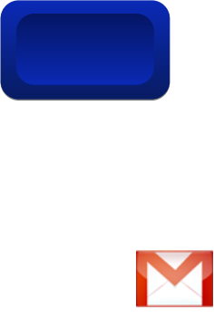








Intents
Home
System picks best component for that action
Photo Gallery
Contacts
“Pick photo”
GMail
Client component makes a request for a specific action
Chat
Blogger
Blogger
New components can use existing functionality

Slide 7
Services
Faceless components that run in the background
  E.g. music player, network download etc…

Slide 8
ContentProviders
Enables sharing of data across applications
  E.g. address book, photo gallery
Provides uniform APIs for:
  querying
  delete, update and insert.
Content is represented by URI and MIME type

Slide 9
Course Objectives
Mobile Application Development (MAD)
Intro to Android platform
Platform architecture
Application building blocks
Development tools
Textbook: Hello, Android

Slide 10
Hello World
A great starting point: http://developer.android.com/guide/tutorials/hello-world.html
Generating UIs
  Views – building blocks
  E.g. TextView, EditText, Button
  Placed into Layouts
  E.g. LinearLayout, TableLayout, AbsoluteLayout

Slide 11
Application Lifecycle
Application run in their own processes (VM, PID)
Processes are started and stopped as needed to run an application's components
Processes may be killed to reclaim resources

Slide 12
Lifecycle
System Process
Home
Mail
Browser
Home
Map
Contacts
GMail

Slide 13
XMPP Services
Allows any app to send device-to-device messages to other android users
Data Messages are Intents with name/value pairs
Works with any gmail account…
Can also build servers to deliver server-to-device messages

Slide 14
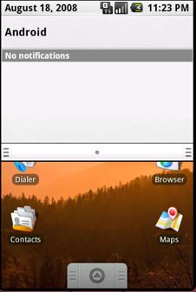
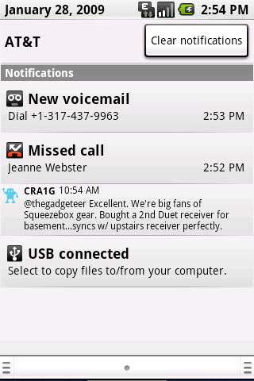
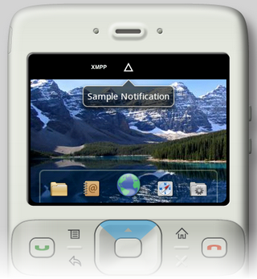
Notification Manager

Slide 15
Notification Manager
How background app interact with users
Consistent notification presentation

Slide 16
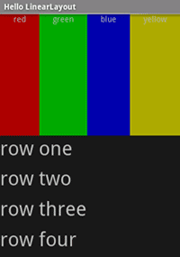
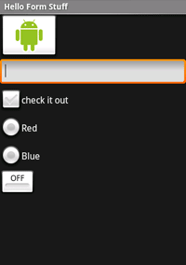
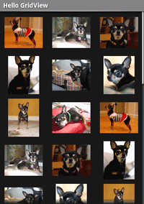
Views

Slide 17
Application Components
Activities – visual user interface focused on a single thing a user can do
Services – no visual interface – they run in the background
Broadcast Receivers – receive and react to broadcast announcements
Content Providers – allow data exchange between applications

Slide 18
Activities
Basic component of most applications
Most applications have several activities that start each other as needed
Each is implemented as a subclass of the base Activity class

Slide 19
Services
Does not have a visual interface
Runs in the background indefinitely
Examples
  Network Downloads
  Playing Music
  TCP/UDP Server
You can bind to a an existing service and control its operation

Slide 20
Broadcast Receivers
Receive and react to broadcast announcements
Extend the class BroadcastReceiver
Examples of broadcasts:
  Low battery, power connected, shutdown, timezone changed, etc.
  Other applications can initiate broadcasts

Slide 21
Content Providers
Makes some of the application data available to other applications
It’s the only way to transfer data between applications in Android (no shared files, shared memory, pipes, etc.)

Slide 22
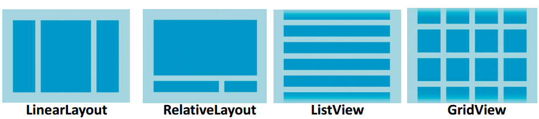
ViewGroup
---specify Layout
android.view.ViewGroup = Layout for views it contains, subclasses include
  android.widget.LinearLayout
  android.widget.AbsoluteLayout
  android.widget.TableLayout
  android.widget.RelativeLayout
  android.widget.FrameLayout
  android.widget.ScrollLayout
Controls location of Views in that ViewGroup
LinearLayout: all children aligned in single direction, horizontally or vertically
RelativeLayout: Child object relative to each other
ListView: a list of scrollable items
GridView: displays items in two-dimensional, scrollable grid

Slide 23
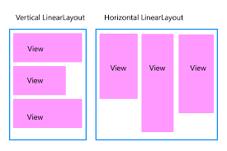
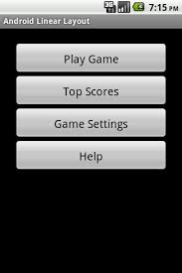
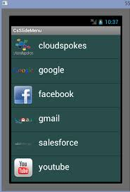
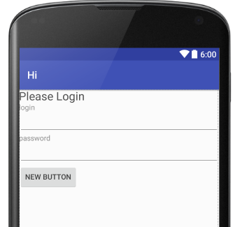
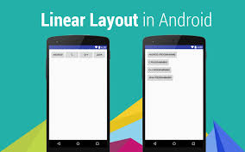
LinearLayout
Good for smaller devices (like phones over Tablets) or when simple interface makes sense
Layout in column (for Vertical) or row (for Horizontal) one after another child View objects
Some Examples
More commonly
used in Vertical
Orientation

Slide 24
LinearLayout
Good:
  Simple
  Know exactly how it will look on every device
Bad:
  Well for many interfaces too simple….

Slide 25
Each View or ViewGroup can have its own set of attributes…but, some are very common
Attribute | Description
layout_width | specifies width of View or ViewGroup
layout_height | specifies height
layout_marginTop | extra space on top
layout_marginBottom | extra space on bottom side
layout_marginLeft | extra space on left side
layout_marginRight | extra space on right side
layout_gravity | how child views are positioned
layout_weight | how much extra space in layout should be allocated to View (only when in LinearLayout or TableView)
layout_x | x-coordinate
layout_y | y-coordinate

Slide 26

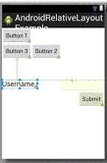
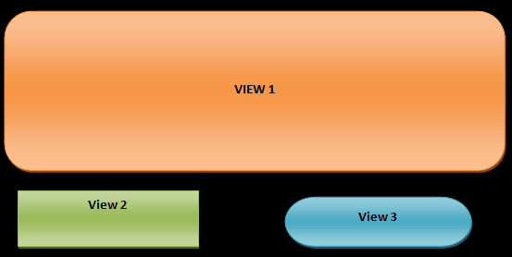
RelativeLayout
GOOD:
  Can give more complex interfaces
  Know what will look like on different sized devices
  Position relative to another position
CAUTION This is meant to be flat –meaning you don’t want/need to nest RelativeLayouts in each other –sometimes may impact speed in rendering and some have reported problems.

Slide 27
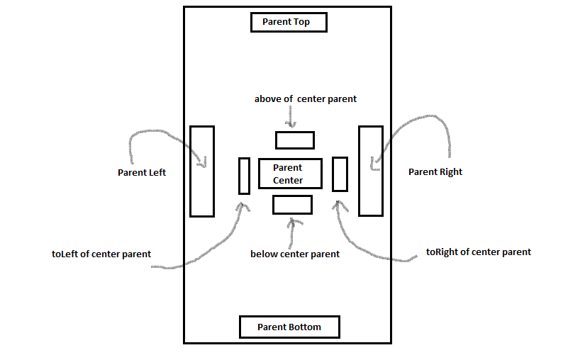
More on RelativeLayout parameters
Center
Top
Bottom
of
Parent

Slide 28
CAUTION --- speed of rendering can be impacted by design choices
Example from developer website
Problem: nesting several instances ofLinearLayout that use the layout_weight parameter can be especially expensive as each child needs to be measured twice.

Slide 29
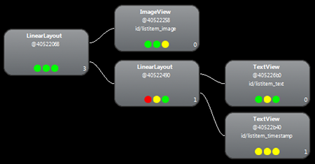
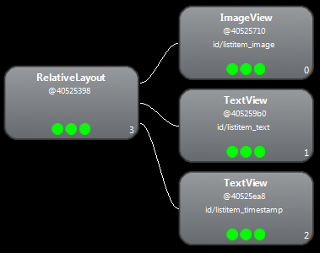
Comparing speeds:
Nested LinearLayout VERSUS RelativeLayout
Nested LinearLayout RelativeLayout
speed: speed:
Measure: 0.977ms
Layout: 0.167ms
Draw: 2.717ms
Measure: 0.598ms
Layout: 0.110ms
Draw: 2.146ms
RelativeLayout is FASTER

